Slide 1
203 Pavement Project
Caltrans District 9

Slide 2
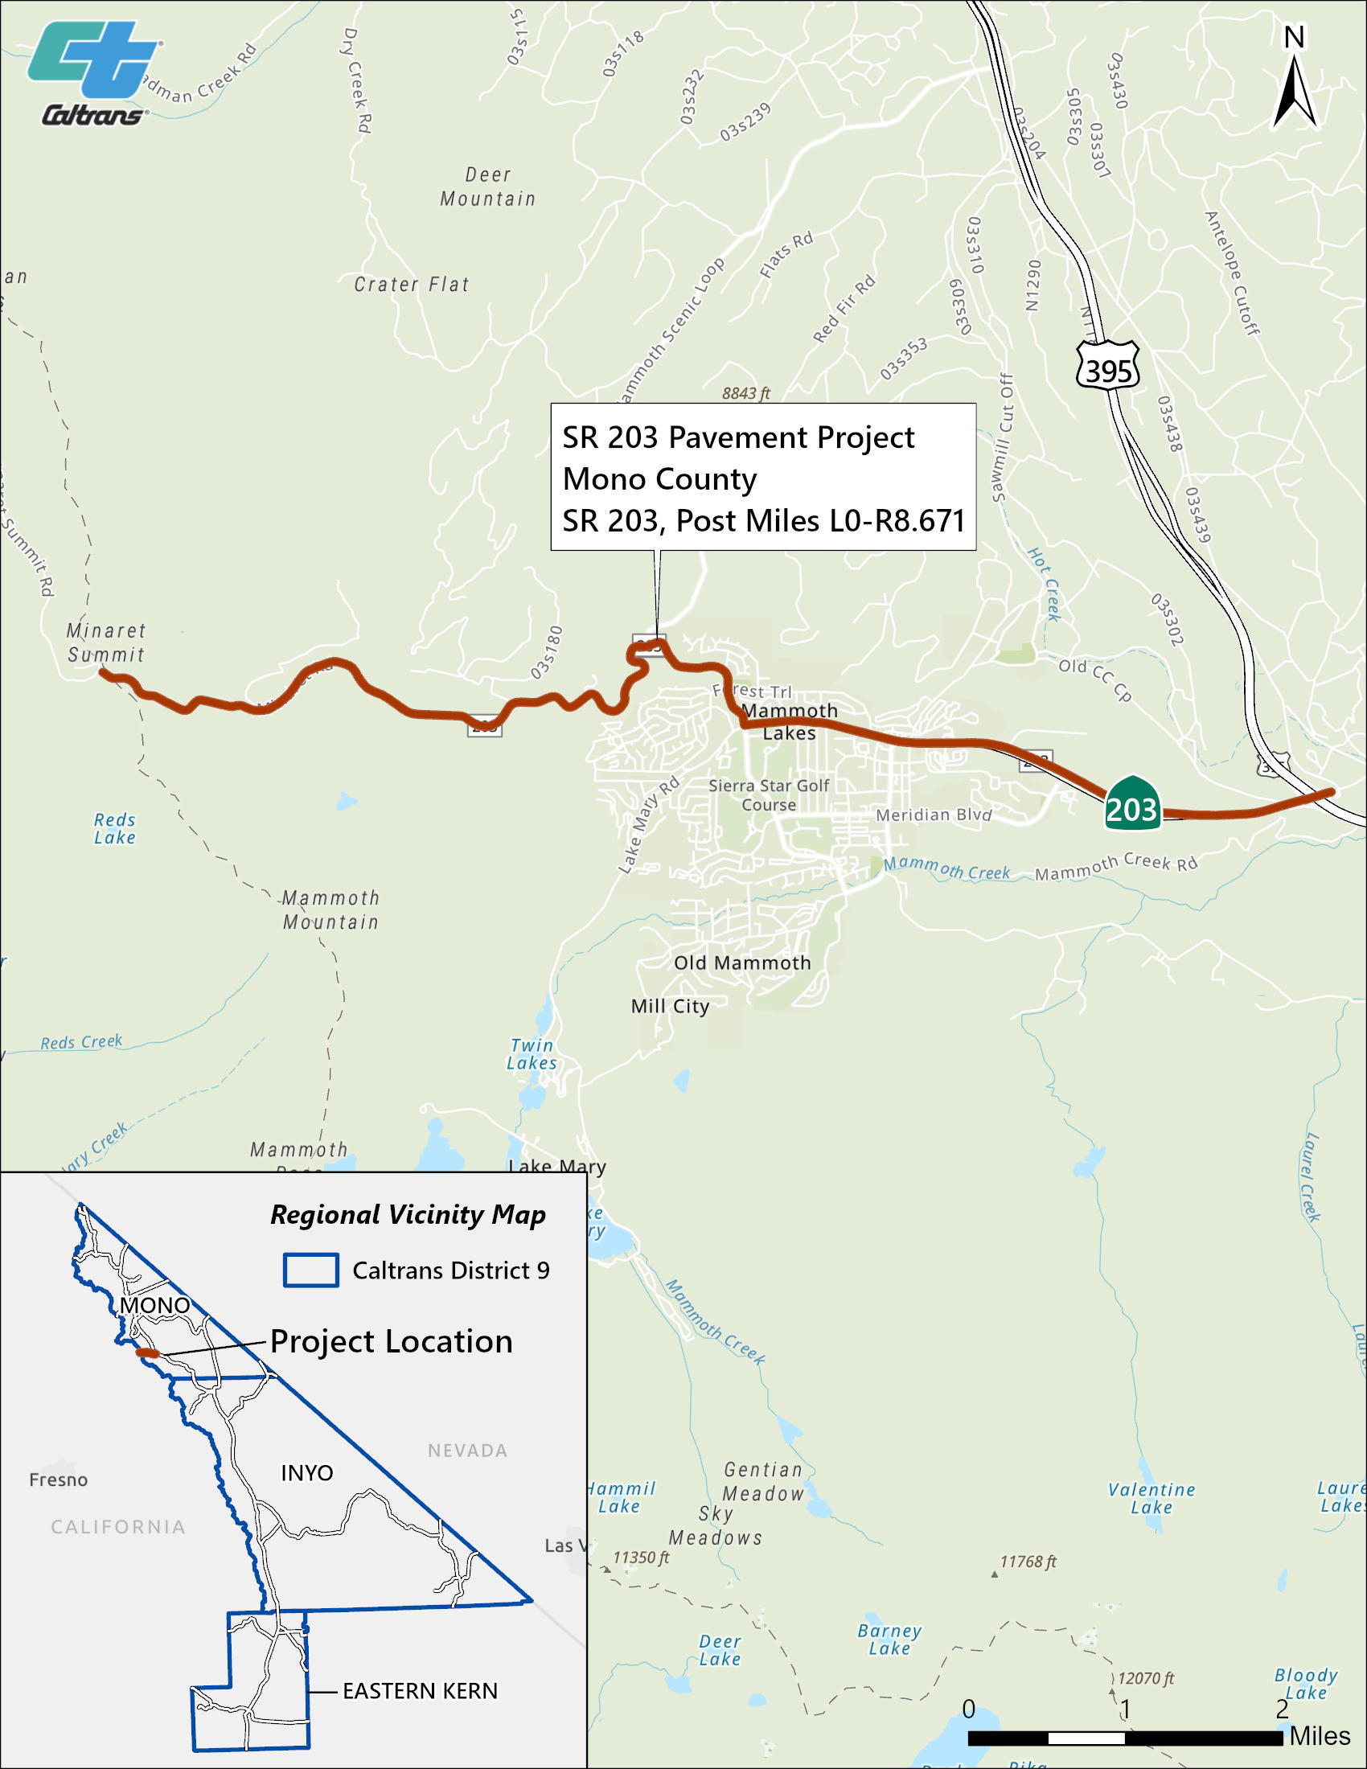
203 Pavement Project
The 203 Pavement Project aims to:
2024 State Highway Operation and Protection Program (SHOPP)
construction Anticipated in 2030
Project Cost: $35.2 m
Anchor asset is Class II pavement
Capital Preventive Maintenance (CAPM) treatment from PM L0.0 (Madera/Mono County Line) to PM 4.782 (Lake Mary/Minaret Roads)
Pavement Rehabilitation from PM 4.782 (Lake Mary/Minaret Roads) to PM R8.7 (end of Route 203)
4,869 linear feet of shoulder widening mostly to facilitate bicycles
14 new or modified curb ramps
10 culverts repaired or replaced
Notes:
There are two build alternatives
This details the elements in Alternative 1 with a programmable cost of $35.2
Alternative 2 includes all of the above and an additional drainage system near the Caltrans Maintenance Station, additional rockfall/erosion mitigation on 7 cut slopes, and a retaining wall replacement.
This project will be programmed in the 2024 SHOPP with PA&ED starting in July 2024

Slide 3
203 Pavement Project Schedule (subject to change)
2026
Project Approval & Environmental Document
2029
Complete Design (5/2029)
2030
Begin Construction (5/2030)
Advertise Project (11/2029)
Complete Construction (11/2030)
(7/2024 - 4/2026)

Slide 4
203 Pavement Public Engagement StoryMap
A public information campaign was executed between May 8, 2023 and May 19, 2023.
The intent was to identify needs not included in the initial project scope.
A description of the proposed project and a description of extra assets that could possibly be included in the project was posted online in ArcGIS StoryMap format.
A survey link was embedded in the online description, and survey comments were received during the engagement period.

Slide 5
203 Pavement Survey Responses
33 people filled out the public engagement survey
66.7% of Respondents reported living in Mammoth Lakes
57.6% of Respondents reported traveling on SR 203 every day
87.9% of Respondents reported their travel mode is “Passenger vehicle as a driver”
51.5% of Respondents reported they also travel on SR 203 via bicycle
Notes:
There were a wide variety of comments ranging from general support to ensuring access to the hospitals.
7 Pavement comments identifying needs between Old Mammoth Road and Minaret, 203 southbound onramp to US 395, filling potholes, and 203 near US 395. All of these areas are included in this project, except for the paving of the south-bound onramp to 395 which can be investigated in PA&ED.
10 Shoulder / Bicycle Access needs were identified. They range from using bike-friendly pavement on the shoulders to dedicated bike lanes. Creating a separate bike facility is outside of the scope of this project, the 203 Pavement project does propose the inclusion of 4,800 feet of shoulder widening will address 5 of the comments received
There was a comment regarding standing water (drainage issue) that will be addressed with this project with the replacement of culverts.
There were 4 pedestrian-related comments that range from replacing sidewalk and curb ramps, creation of MUP, pedestrian under-crossings, and more crosswalks. While many of these items are outside of the scope of the project, 14 new or modified curb ramps are being identified in this project along with investigating new signage for pedestrian crossings.
Roundabouts and traffic signal fall outside of the scope of this pavement project.

Slide 6
203 Pavement
Survey Responses – Locations Identified in the comments
203 Pavement Project Feature Locations
Notes:
This is a transition slide:
The top map shows where the public identified areas of needed improvements, and the bottom map shows the areas where this project proposes features.
I will now go into more project specifics.

Slide 7
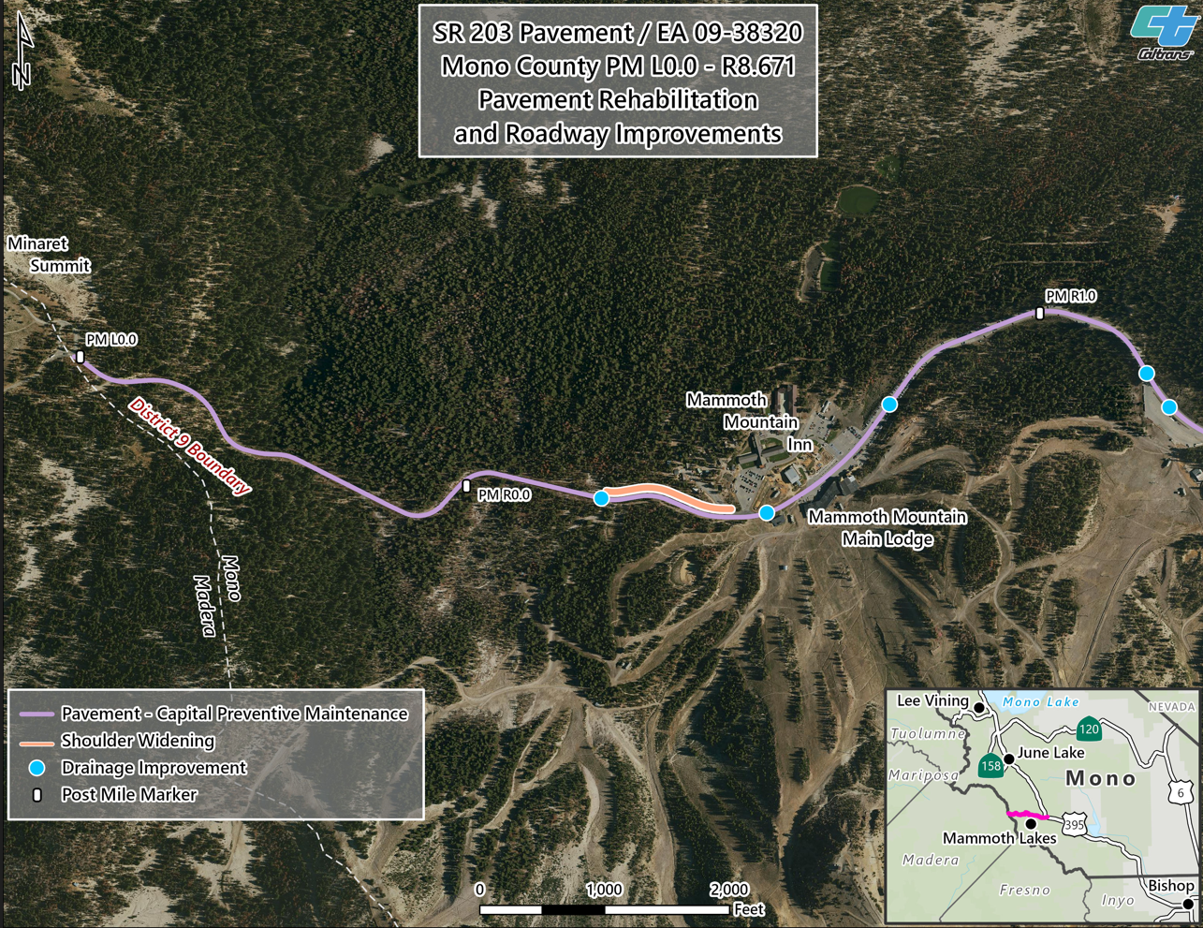
203 Pavement
Notes:
PM L0.1 - PM R0.59: A 0.15’ asphalt concrete overlay is proposed. The asphalt concrete overlay will extend from edge of pavement to edge of pavement. As a result, shoulder backing will be required.
PM R0.59 - PM R4.78: The existing asphalt concrete pavement will be removed to a depth of 0.25’ and will be replaced with 0.25’ of new asphalt concrete pavement. The removal and replacement will be limited to the existing traveled way. Work on the shoulders will consist of minor digout repairs and placement of a fog seal and will be limited to the standard shoulder width (8') or less. No shoulder backing will be placed in this section.
The existing westbound shoulder will be widened to provide a 4’ bike lane between the Mammoth Mountain Inn and a Mammoth Mountain access road.
The drainage will be replaced or repaired in five locations in this section.

Slide 8
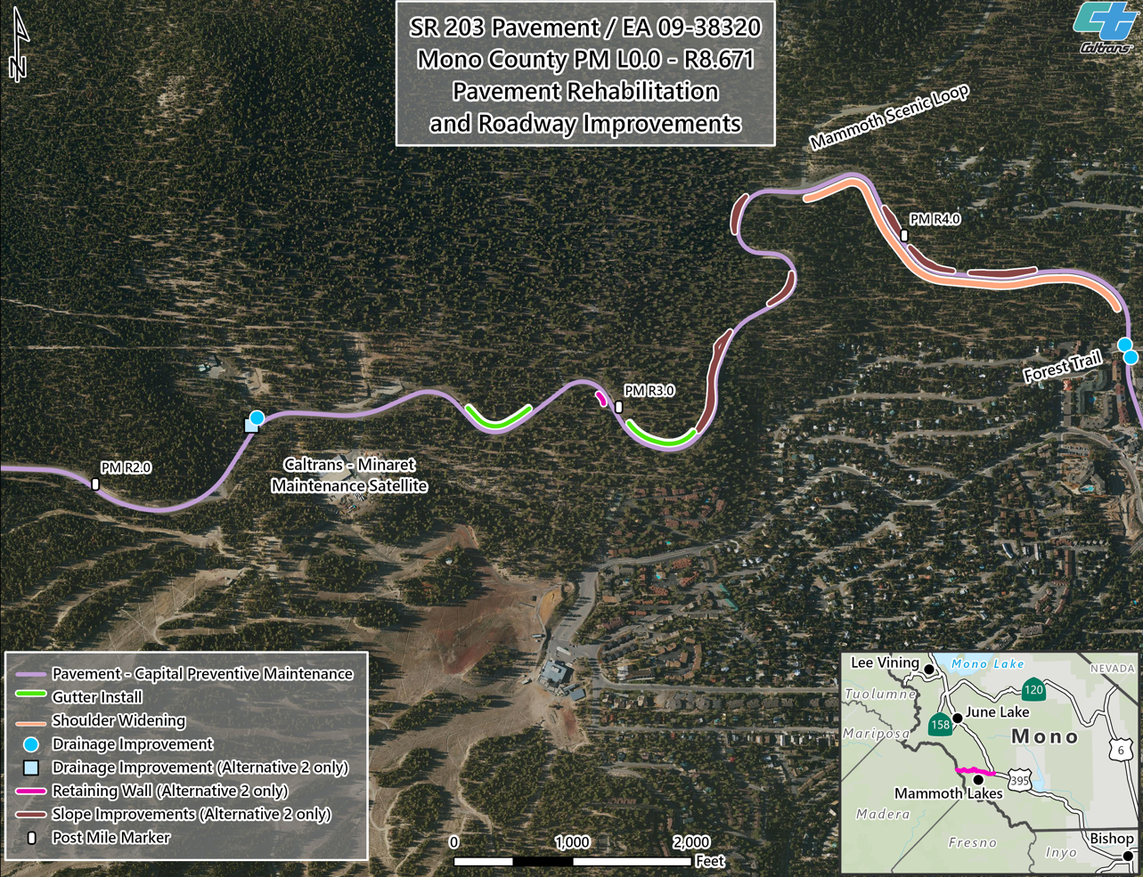
203 Pavement
Notes:
The drainage will be repaired at the Caltrans Maintenance Station. In Alternative 2, The existing concrete swale at PM R2.39 (CT Maintenance Station entrance) will be replaced with a drop inlet and 24" CSP. The new drainage system will drain into the existing channel on the northeast side of the Maintenance Station entrance.
The existing AC dike that has been damaged by snowplow operations will be replaced. The locations vary, but the estimated quantity is 1,000 linear feet.
The existing eastbound shoulder will be widened to provide a 4' bike lane between the Mammoth Scenic Loop Road and Forest Trail Road.
In Alternative 2 - A reinforced concrete retaining wall is proposed at PM R3.01 (Earthquake Fault). The proposed retaining wall will replace an existing rock fill and will wrap around the shoulder of the adjacent pullout to stabilize the existing shoulders. The retaining wall is anticipated to be approximately 15' high and 100' in length.
Alternative 2 also includes additional rockfall and erosion mitigation on 7 cut slopes.

Slide 9
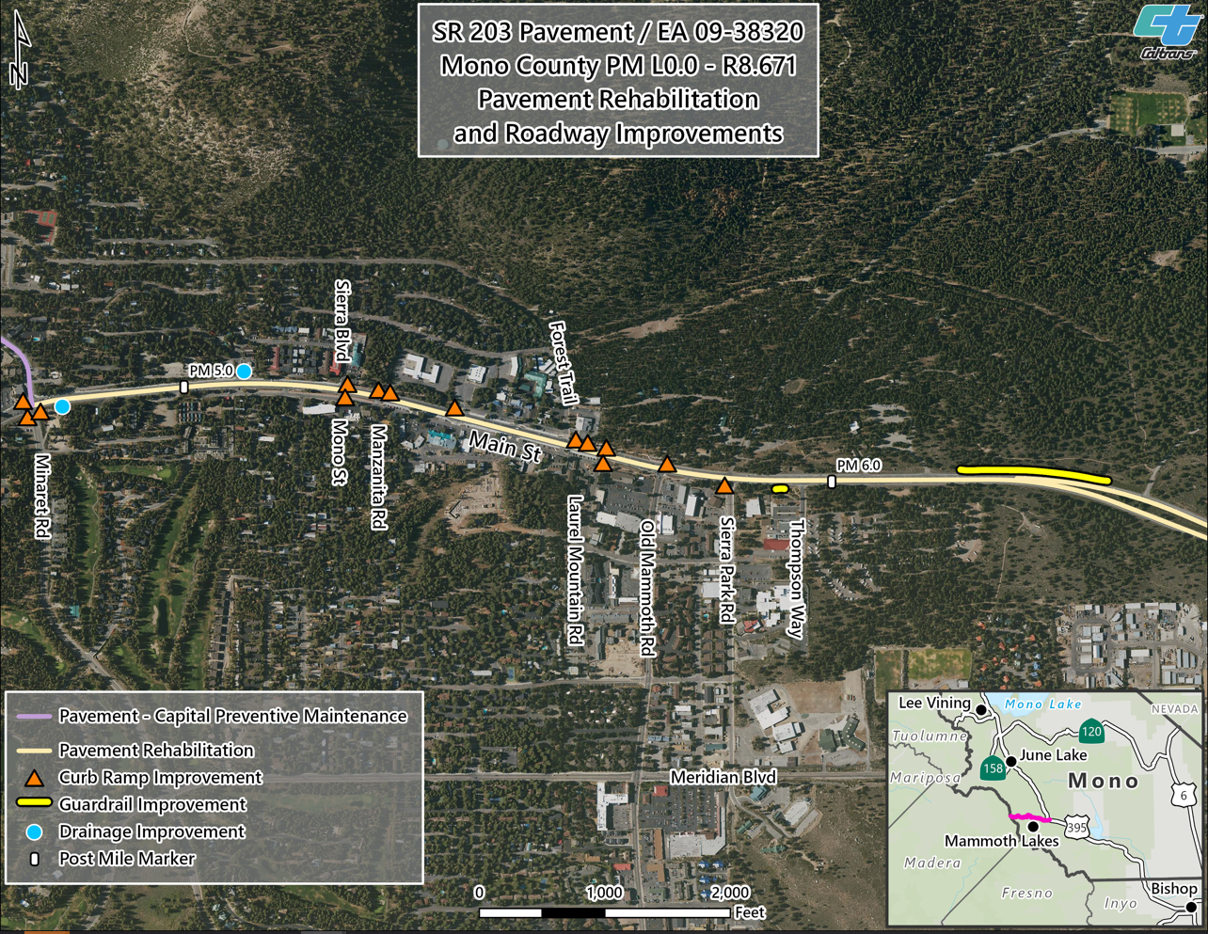
203 Pavement
Notes:
PM R4.78 - PM R8.67 (PM 6.3 - PM R7.78 Westbound only): The existing asphalt concrete pavement will be removed to a depth of 0.40’ and will be replaced with 0.40’ of new asphalt concrete pavement. The removal and replacement will be limited to the existing traveled way, including the median area, but will also include shoulder areas where the pavement has failed.
PM 6.3 - PM R7.78, Eastbound: A full depth recycle using foamed asphalt (FDR-FA) will be performed on the existing traveled way. The thickness will be approximately 0.95'. An 0.20' thick asphalt concrete overlay will then be placed over the FDR-FA from edge of pavement to edge of pavement. Due to the increase in roadway profile, shoulder backing will be required.
Replace 14 existing curb ramps to meet current ADA standards, and associated work required to tie the new curb ramp into the existing sidewalks and roadway.
The existing guardrail will be upgraded to Midwest Guardrail System (MGS), including appropriate terminal sections.
In 2 drainage locations systems will be repaired or replaced.

Slide 10
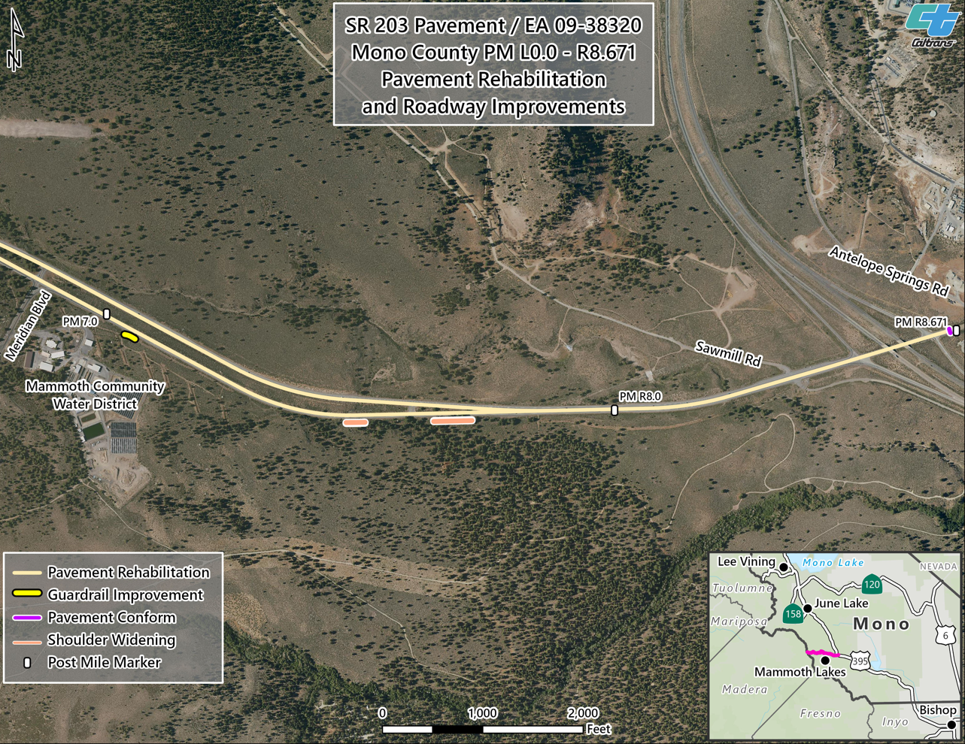
203 Pavement
Notes:
The existing guardrail will be upgraded to Midwest Guardrail System (MGS), including appropriate terminal sections.
An existing rock outcrop will be removed from the existing eastbound shoulder at PM 7.5to provide a standard 8' shoulder.

Slide 11
Thank you -

